Slide 1
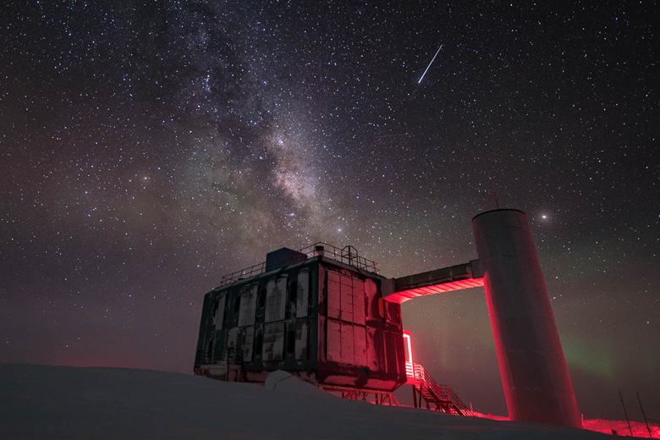
The IceCube Neutrino Observatory: The Perfect Muon Detector Unraveling Cosmic Secrets
Pascal Gutjahr
TU Dortmund University
pascal.gutjahr@tu-dortmund.de
LPC – Clermont-Ferrand
06.10.2023
icecube..wisc.edu

Slide 2

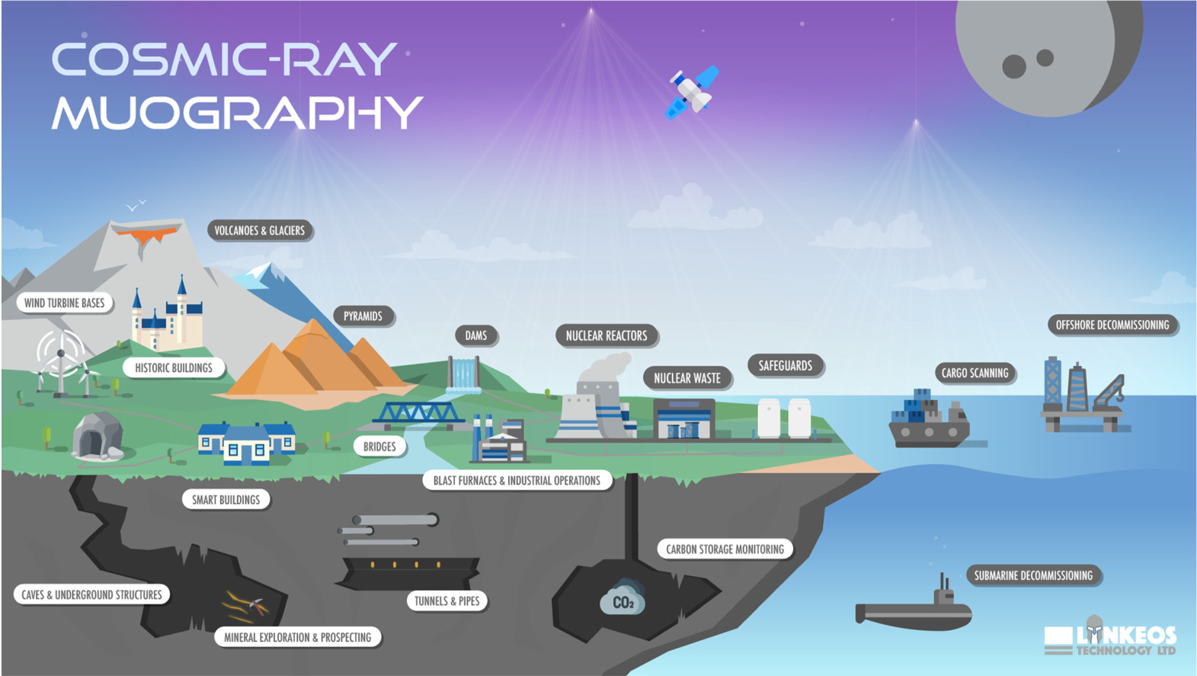
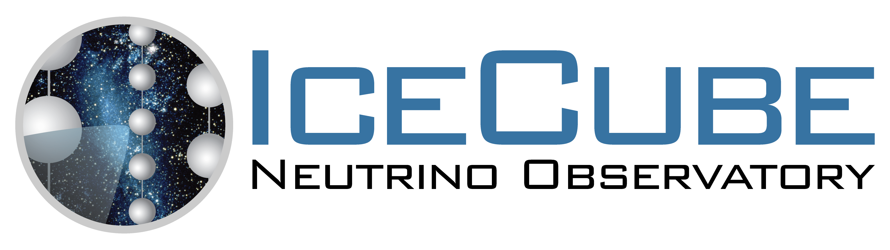

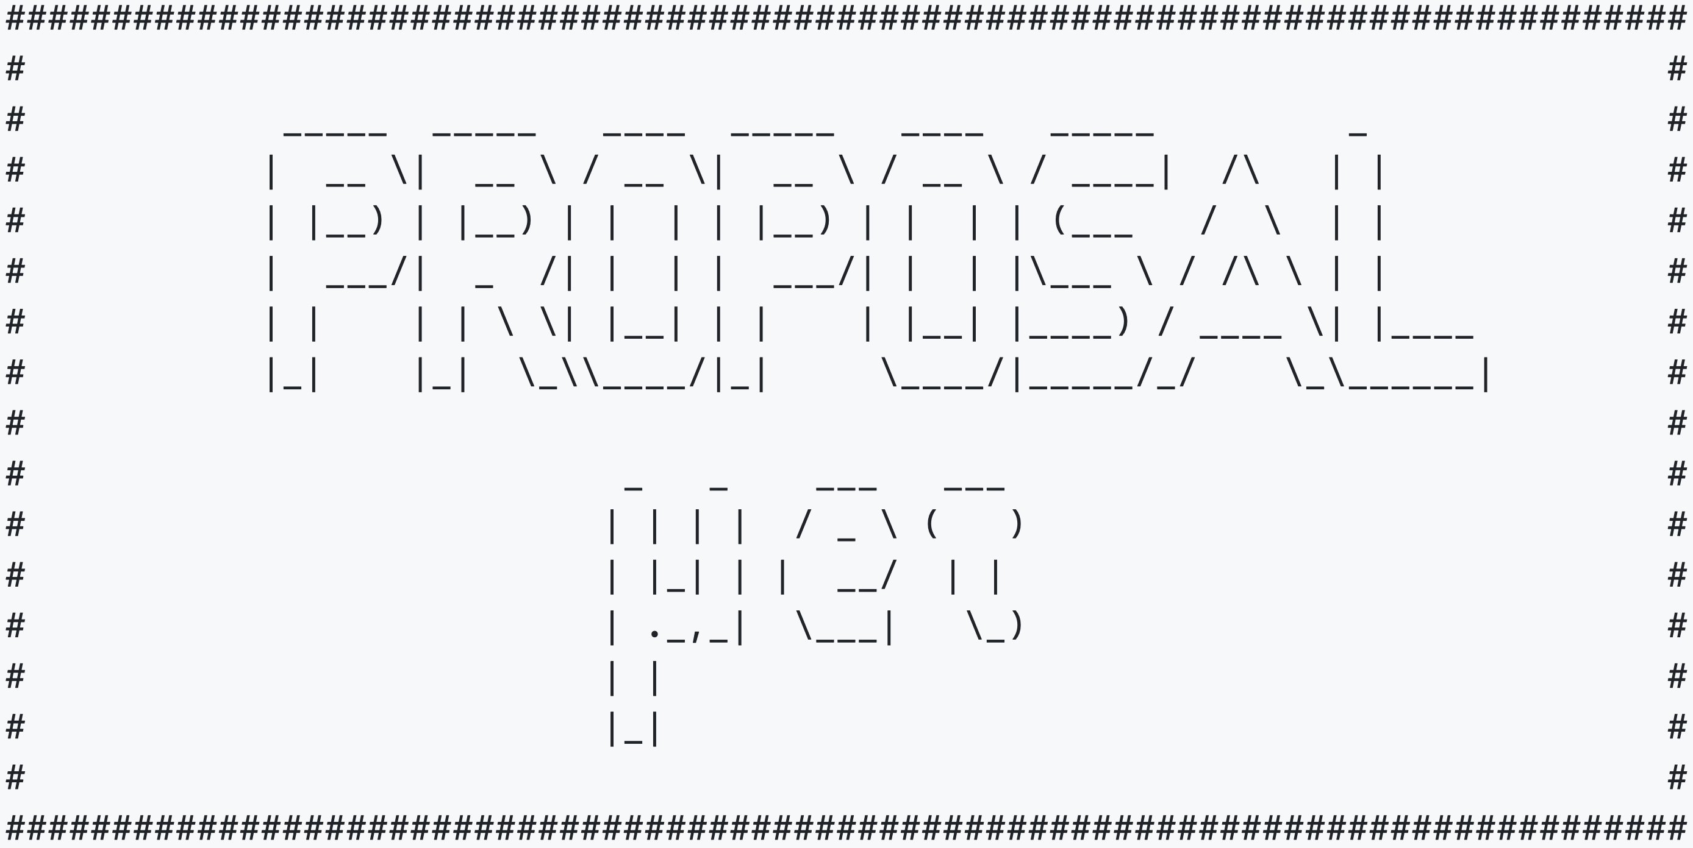

Pascal Thomas Gutjahr
B.Sc. Medical Physics
ATLAS
testing silicon strip sensors
M.Sc. Physics
IceCube
studying and analyzing muon deflection
PhD Student
IceCube
energy and direction reconstructions
cosmic ray physics – prompt component
Muography
observering water level in coal mines
PROPOSAL
software for lepton propagation

Slide 3
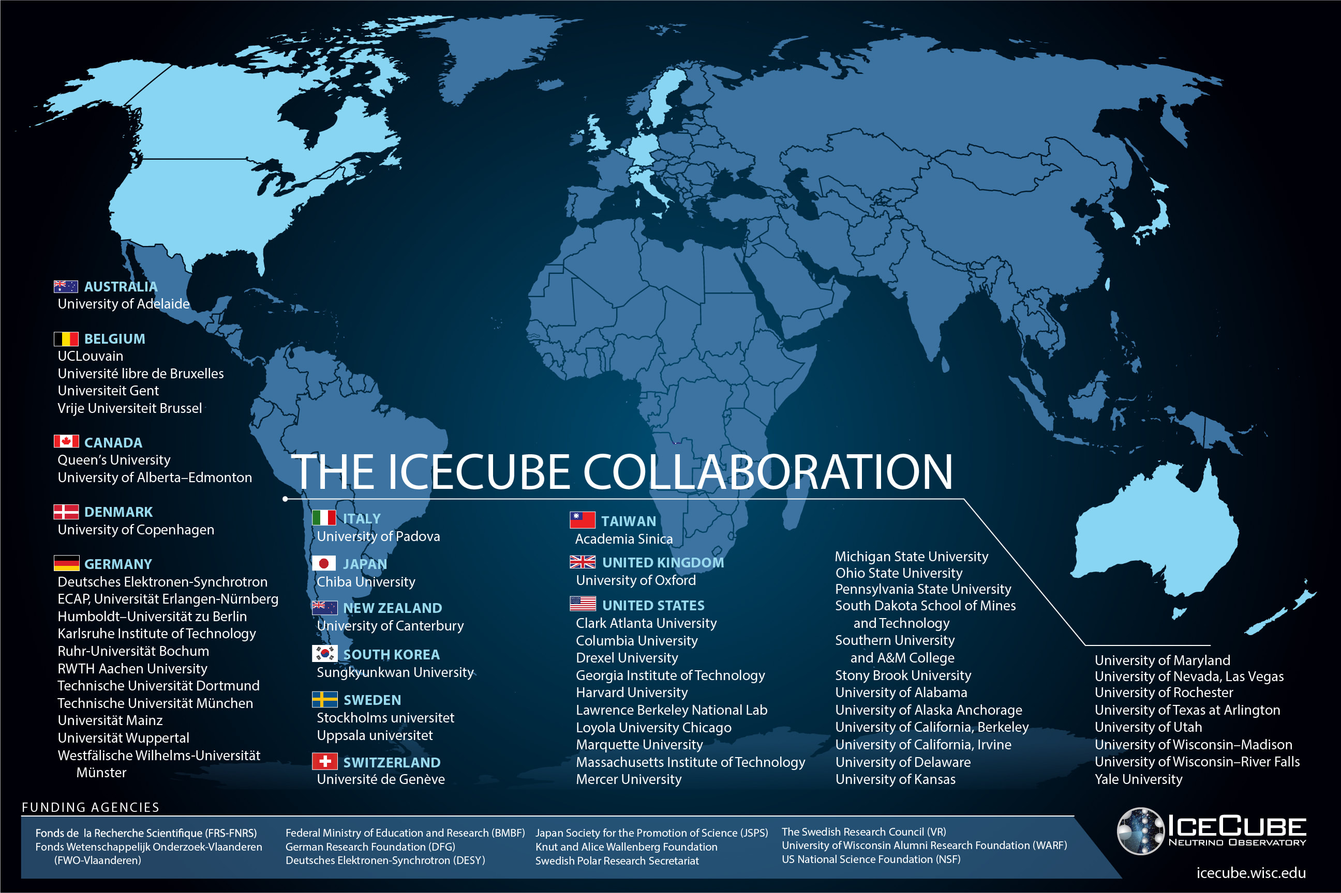

Slide 4
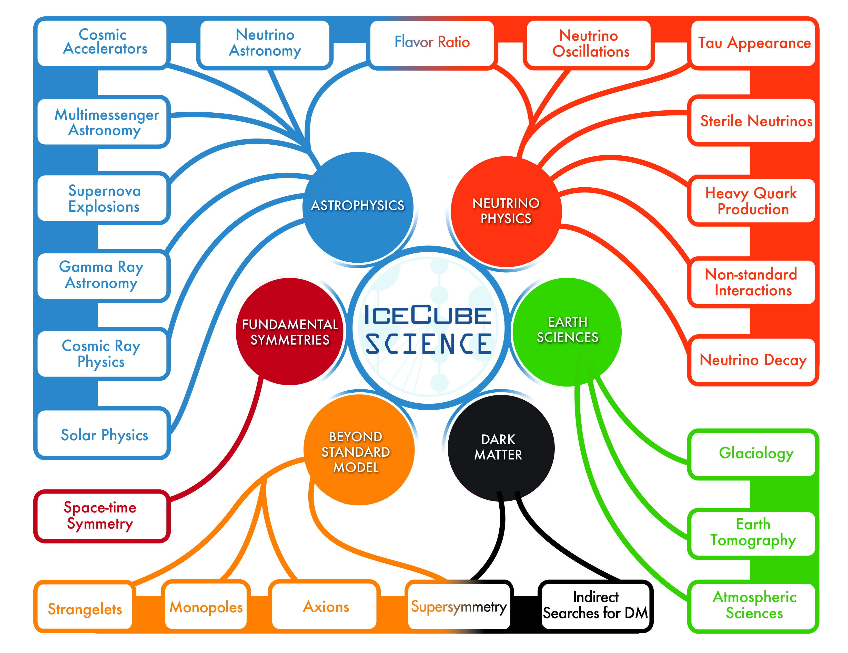
gallery.icecube.wisc.edu

Slide 5
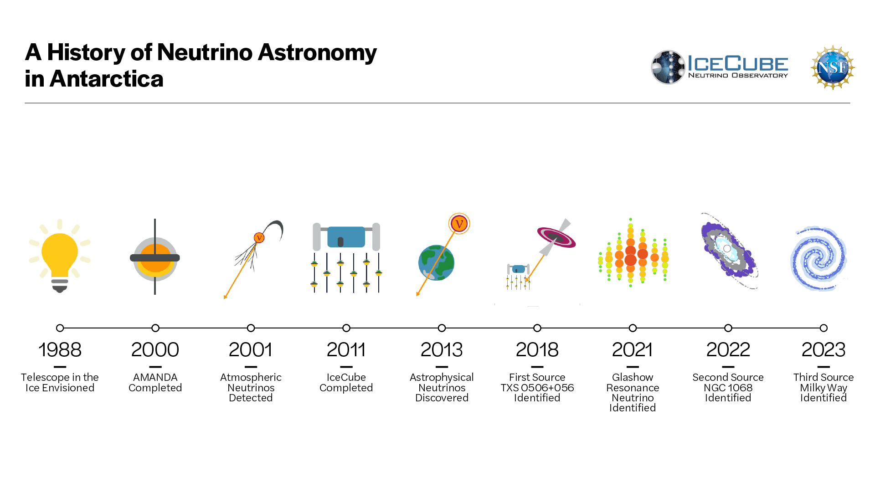
5

Slide 6
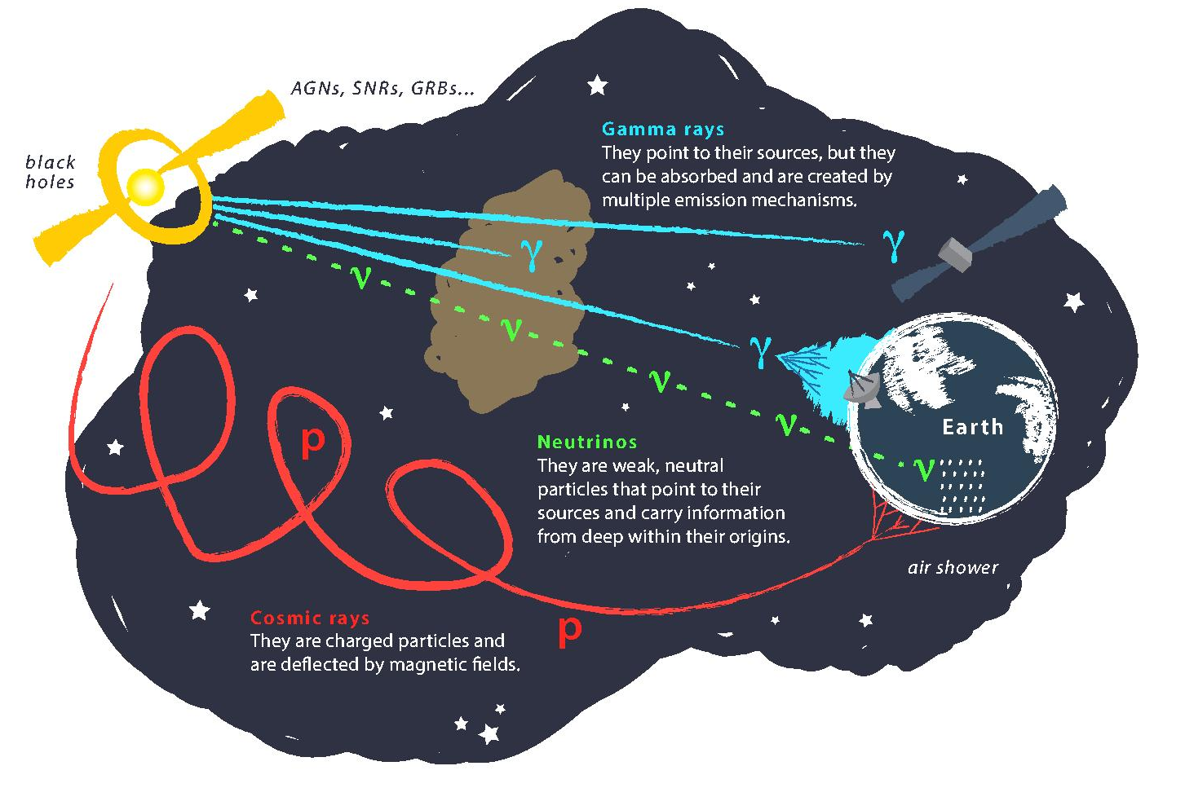
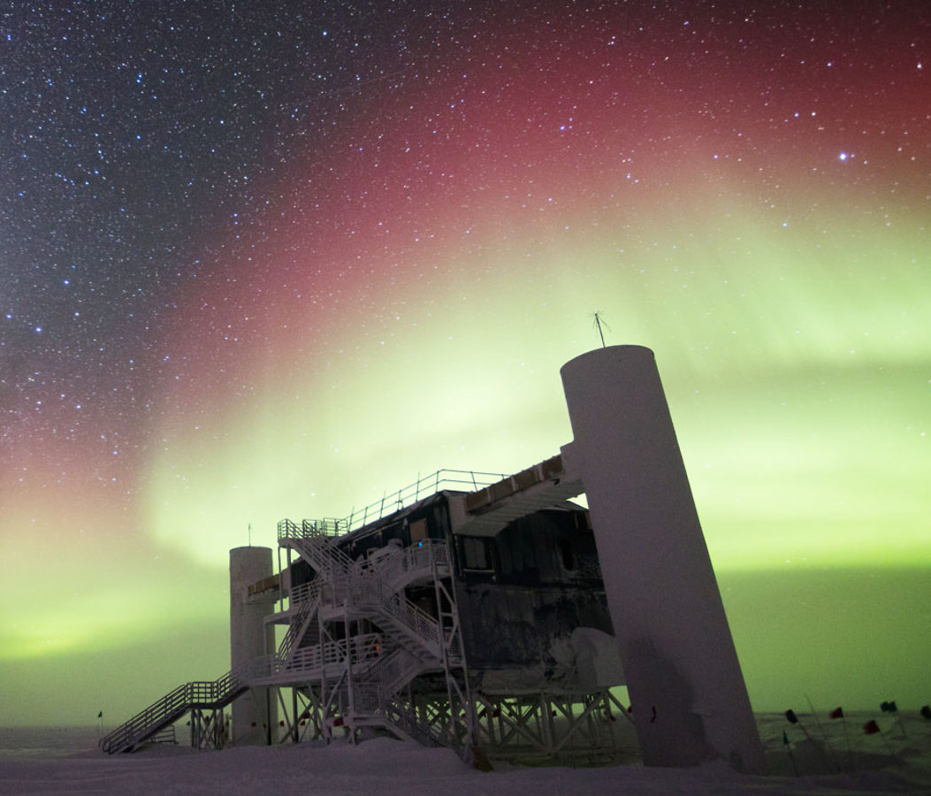
Astroparticle Physics
gallery.icecube.wisc.edu
Credit: IceCube / NSF

Slide 7
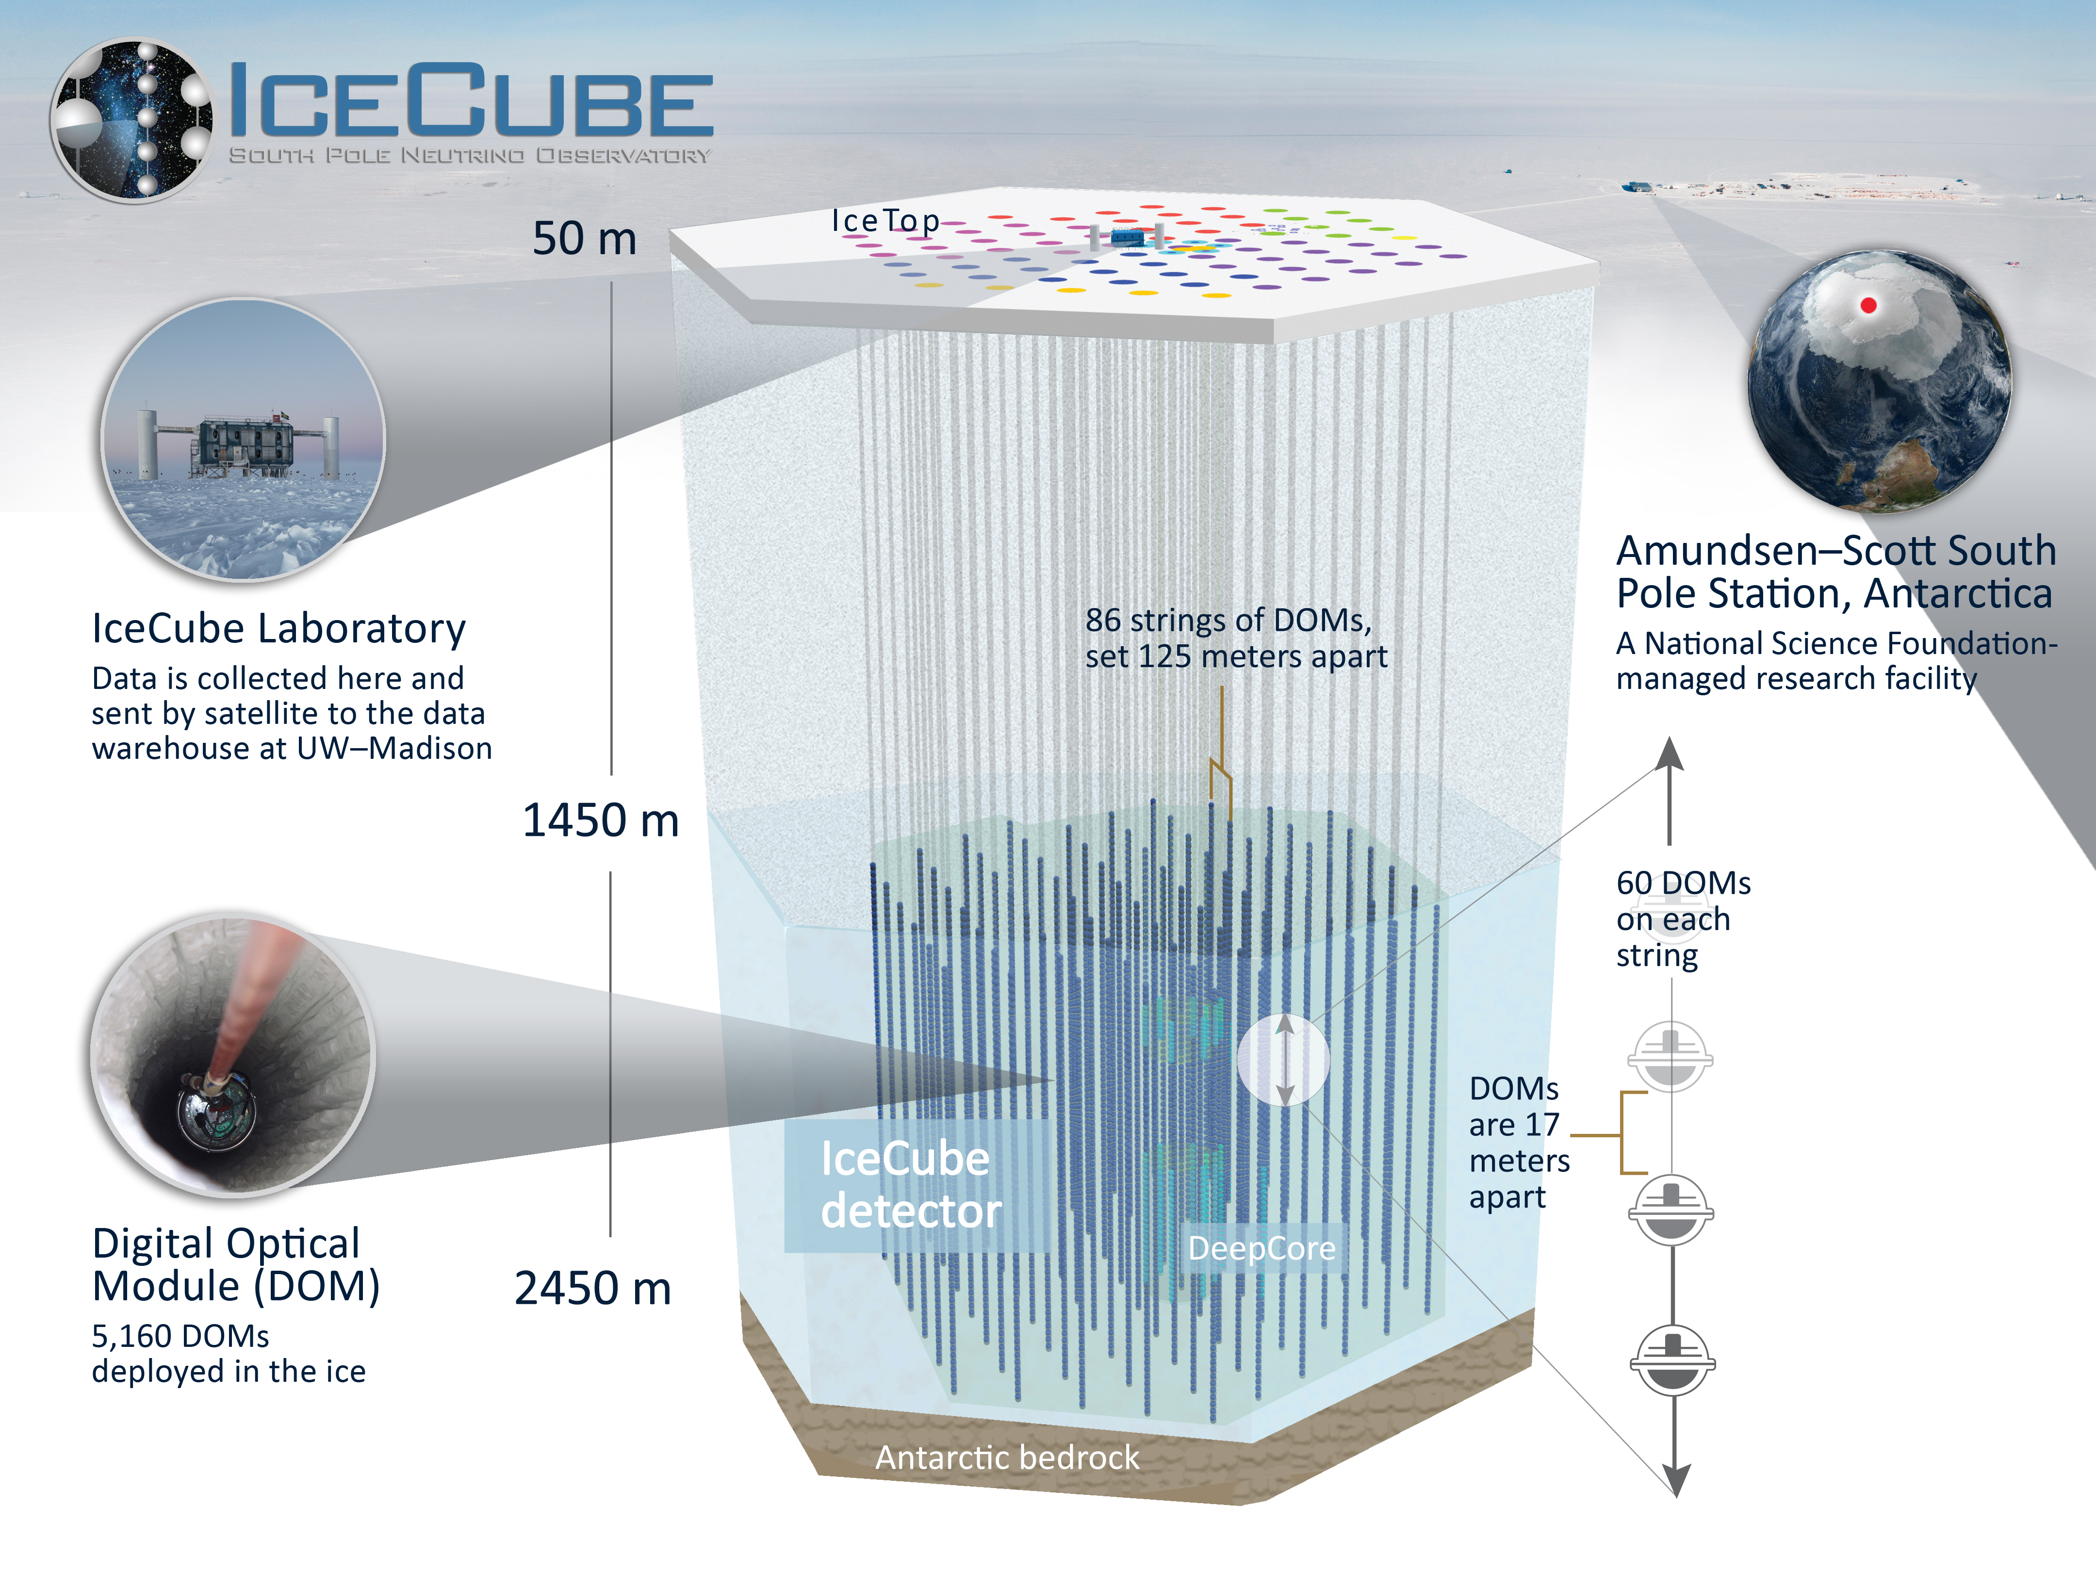
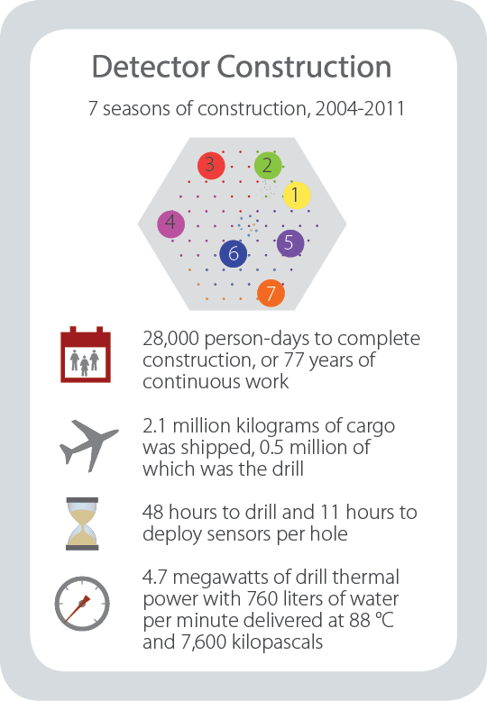
gallery.icecube.wisc.edu

Slide 8
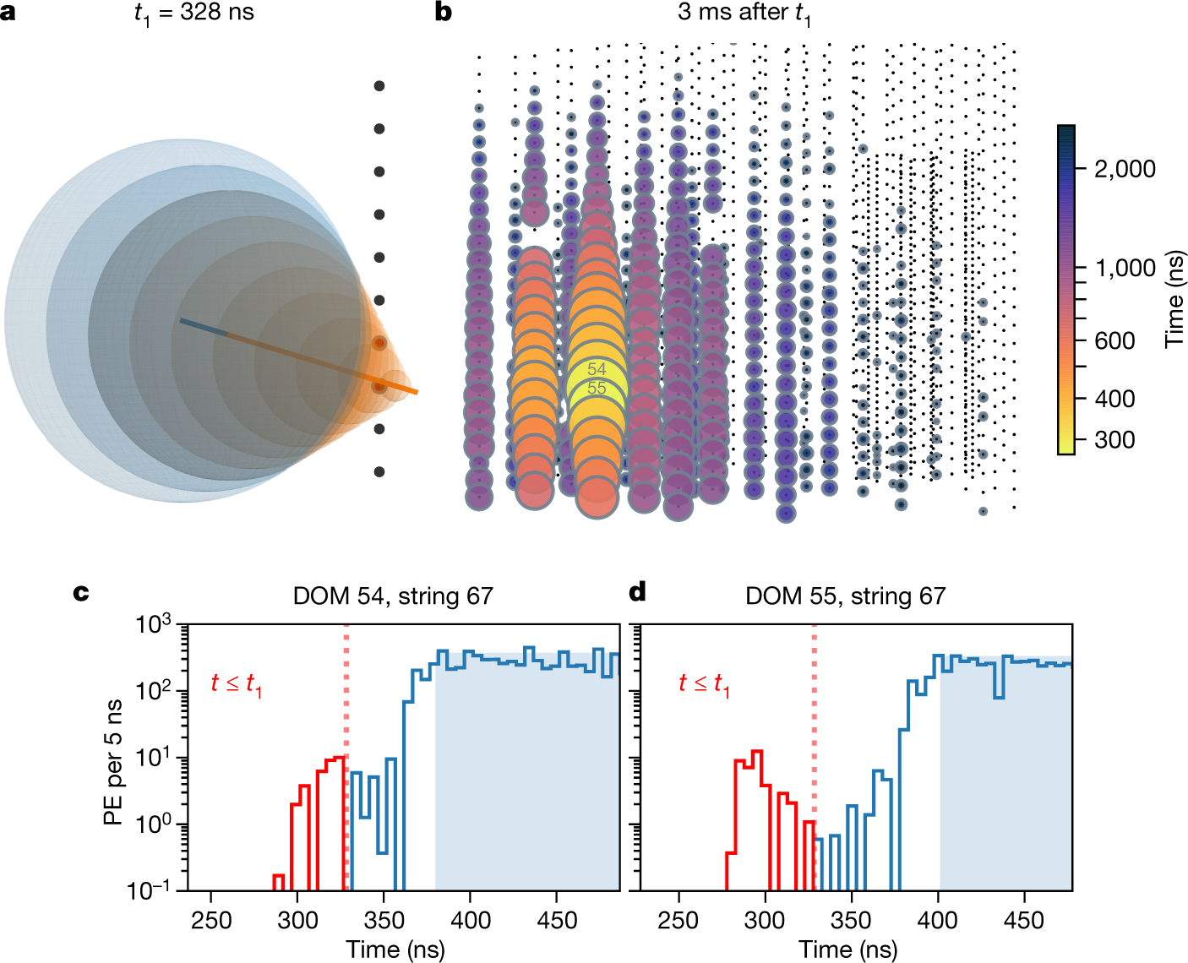
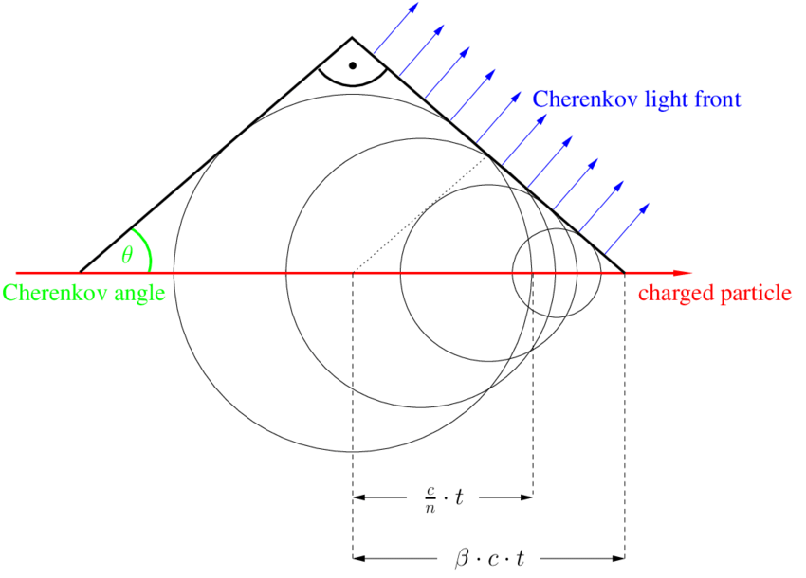
Particle Detection – Cherenkov Light
10.1038/s41586-021-03256-1
T. Gluesenkamp

Slide 9
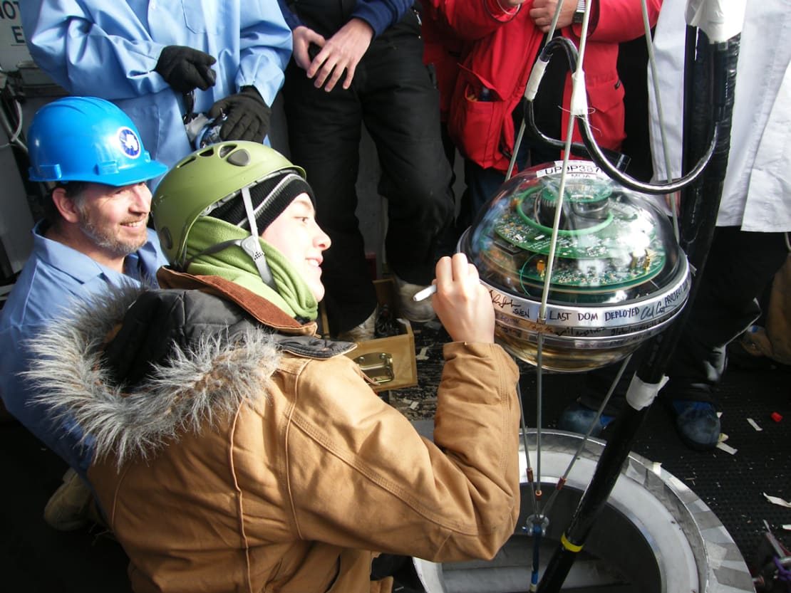
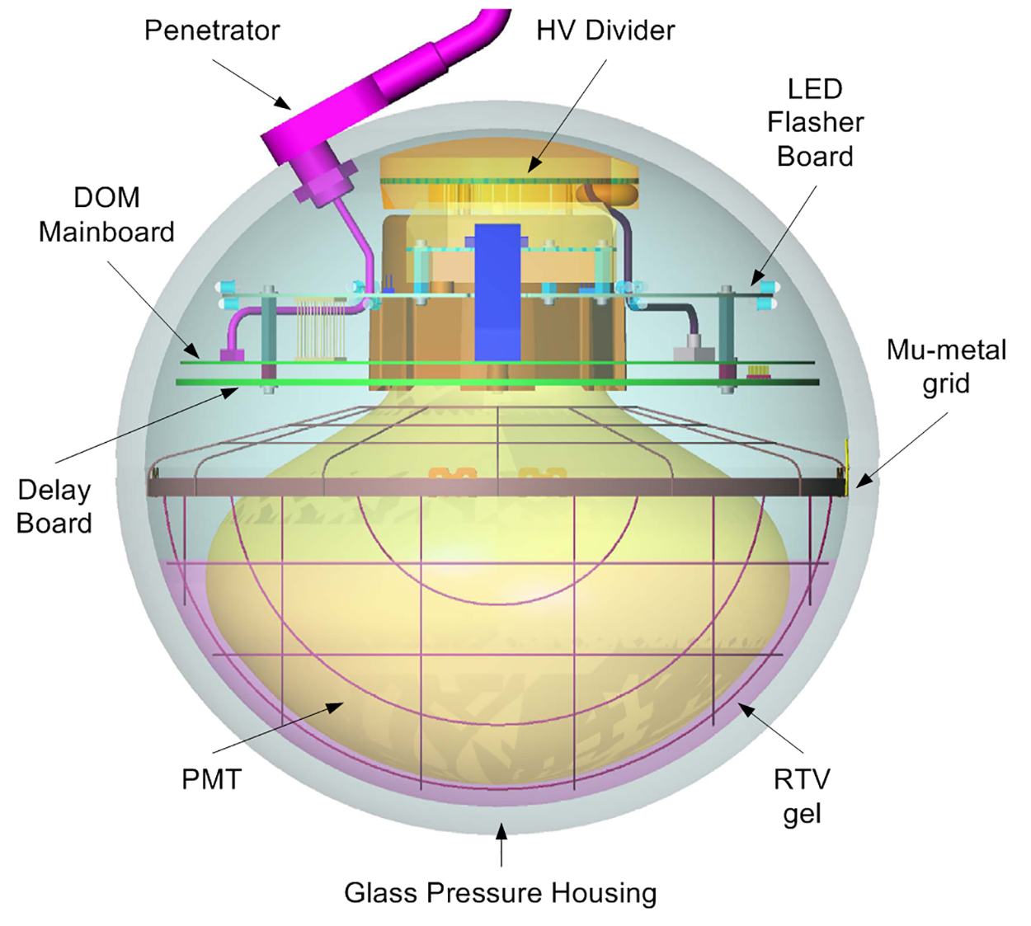
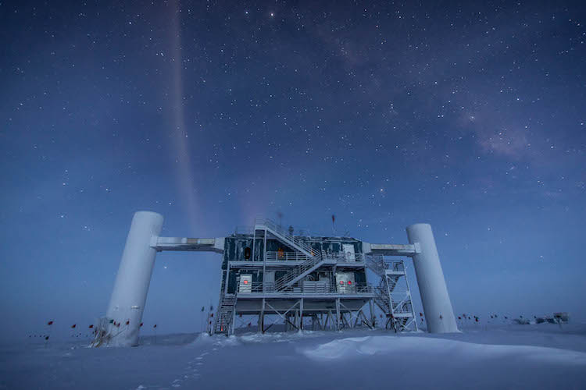
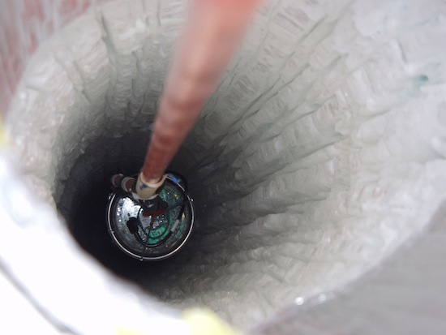
Digital Optical Module (DOM)
icecube.wisc.edu
phys.org
icecube.wisc.edu

Slide 10
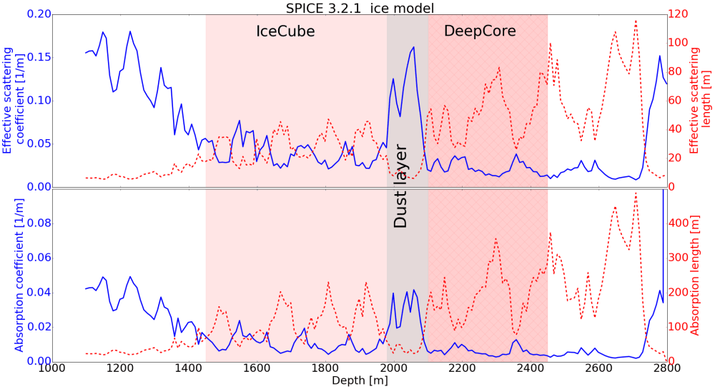
Detection Medium - Ice
icecube..wisc.edu

Slide 11
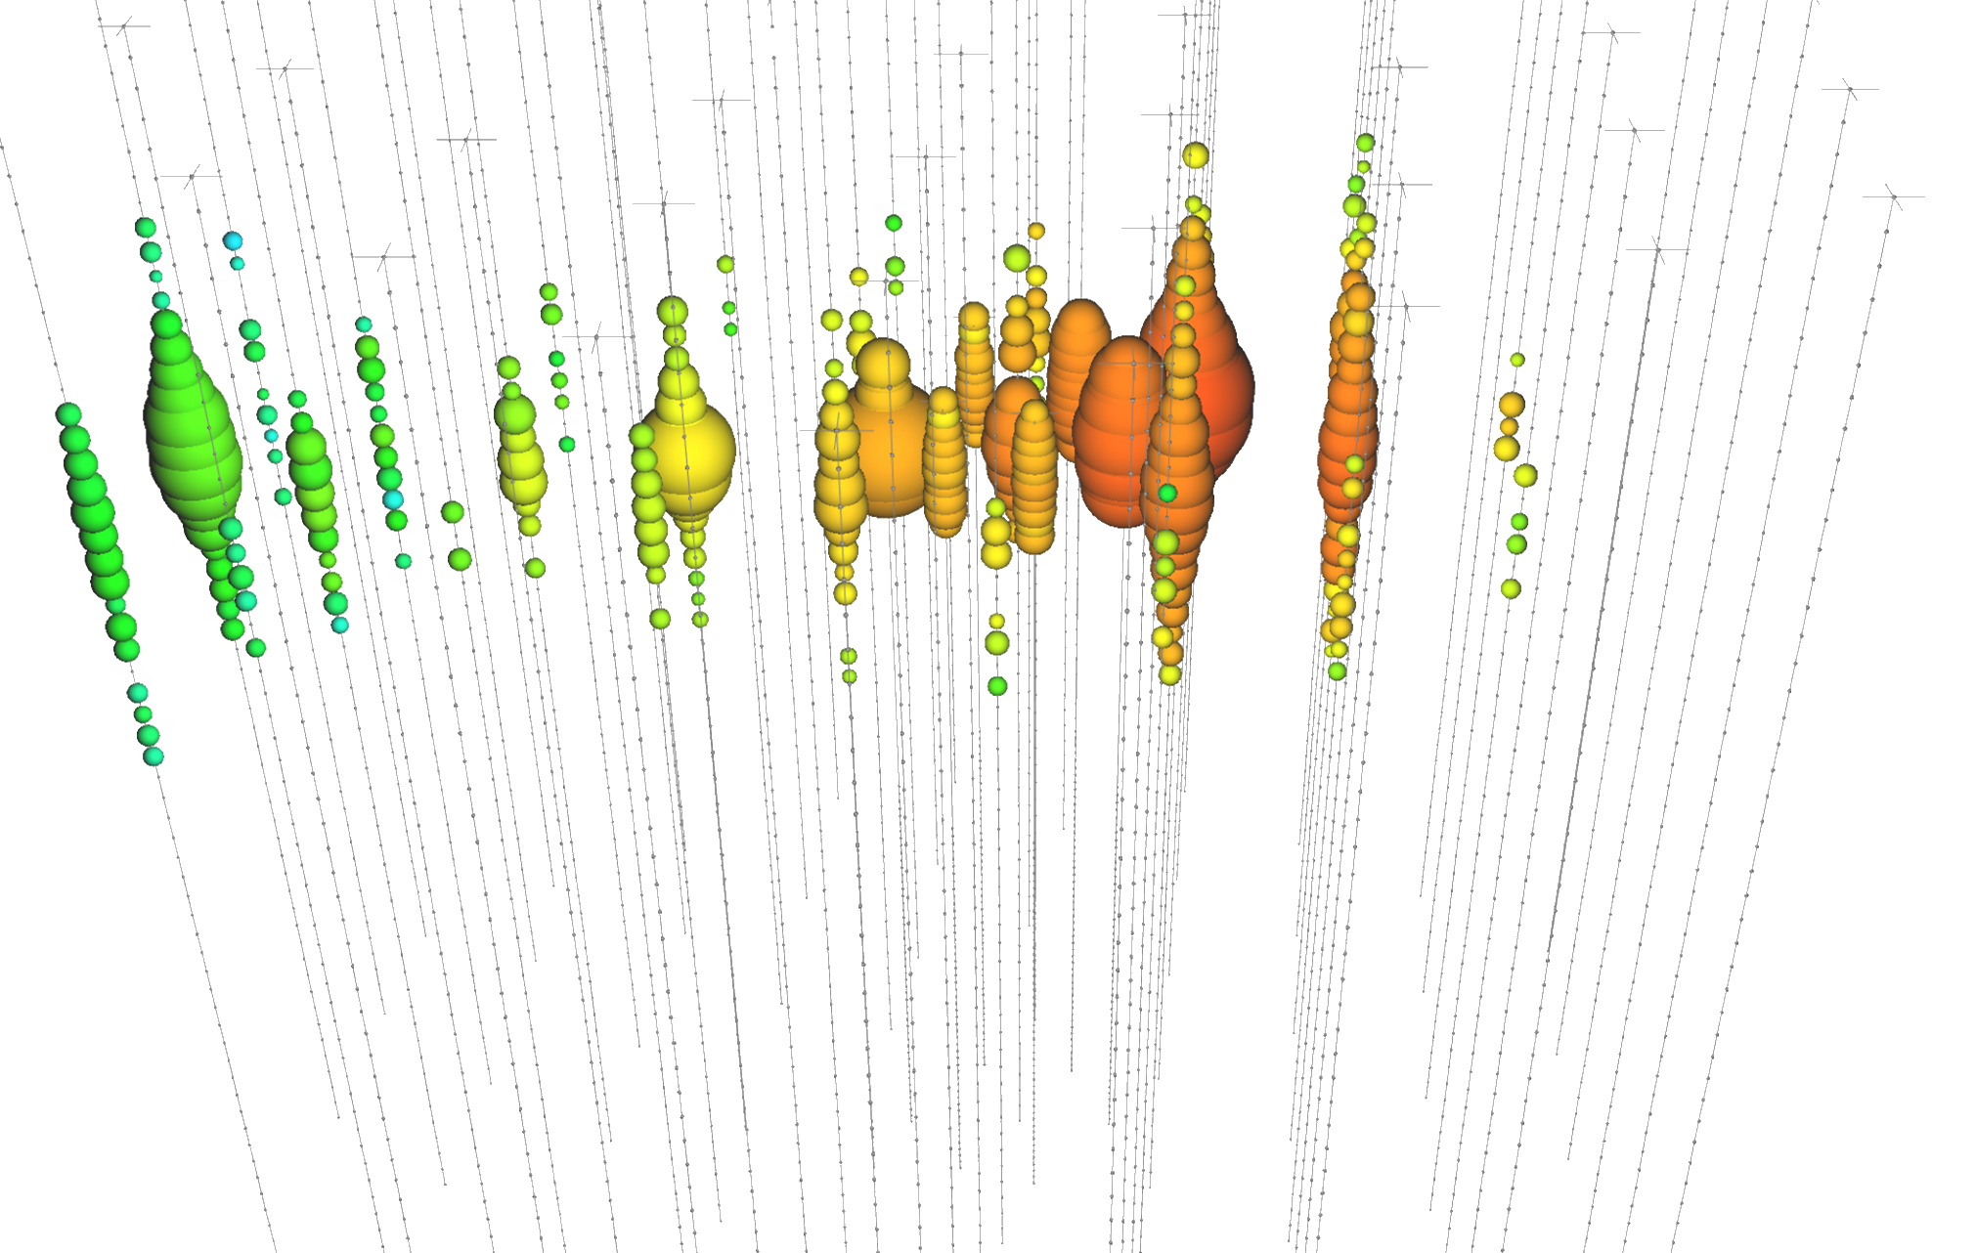
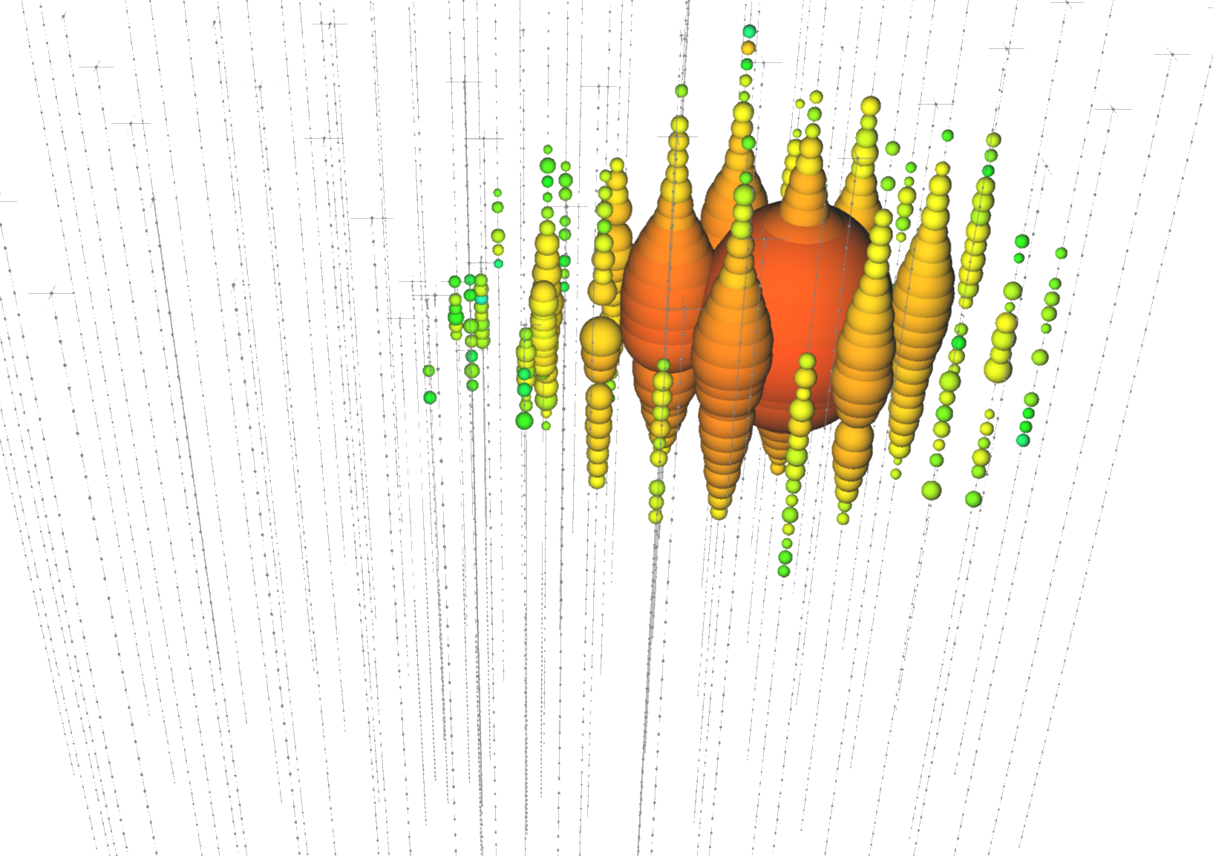
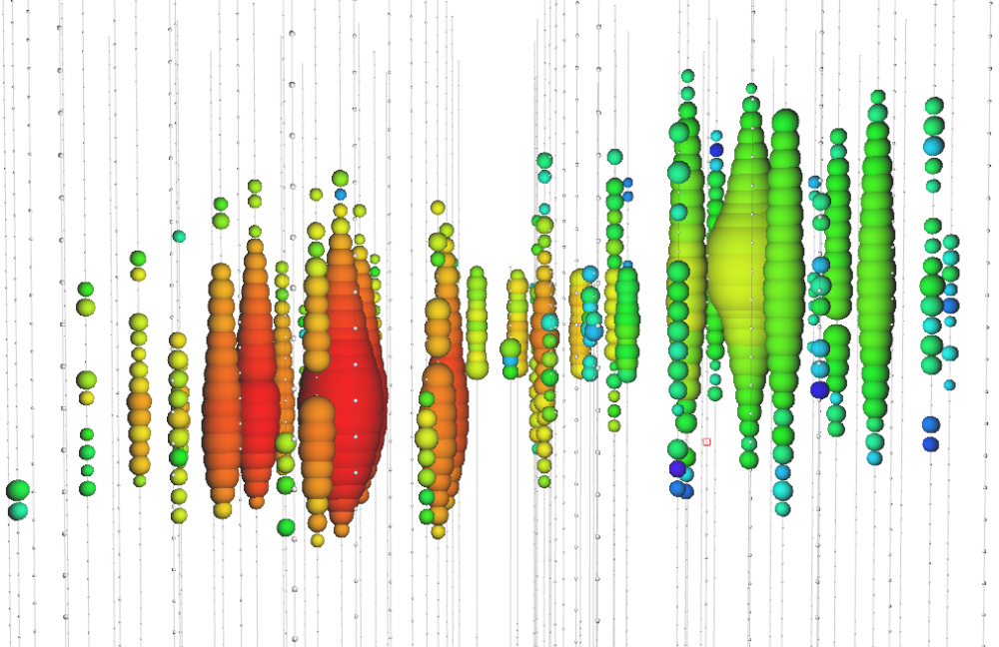
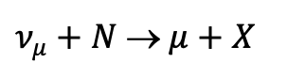
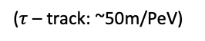
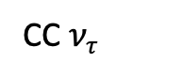
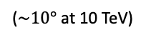
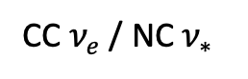
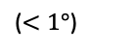
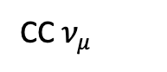
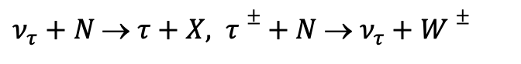
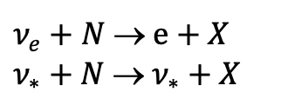
Event Topologies
CC $ν_{μ}$
CC $ν_{e}$ / NC $ν_{∗}$
CC $ν_{τ}$
icecube.wisc.edu
$ν_{μ}+N$ → $μ+X$
$ν_{e}+N$ → $e+X$
$ν_{∗}+N$ → $ν_{∗}+X$
$ν_{τ}+N$ → $τ+X, τ±+ N$ → $ν_{τ}+W±$
Track
Cascade
Cascade / Track / Double-Cascade
($<1°$)
($\sim 10°$ at 10 TeV)
($τ$ – track: ~50m/PeV)

Slide 12
12

Slide 13

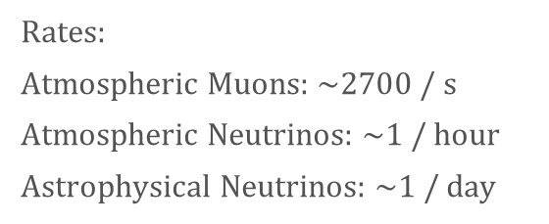
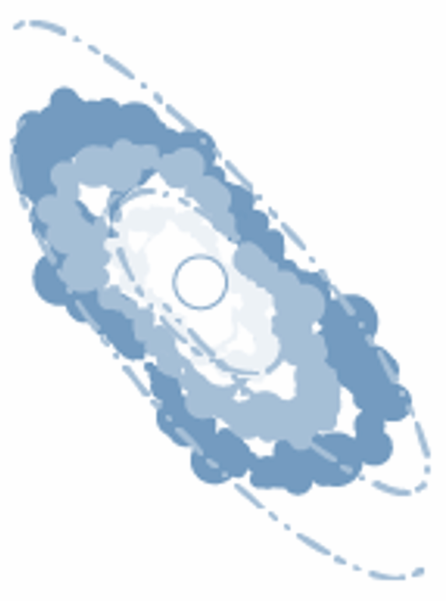
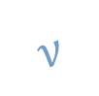


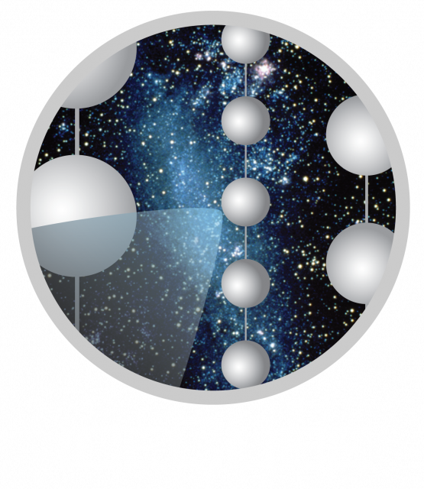
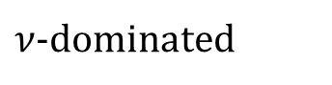
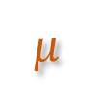
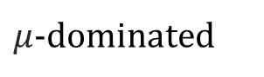
Air Shower - Background
Astrophysical Source
Atmosphere
(not to scale)
Air shower
Air shower

Slide 14
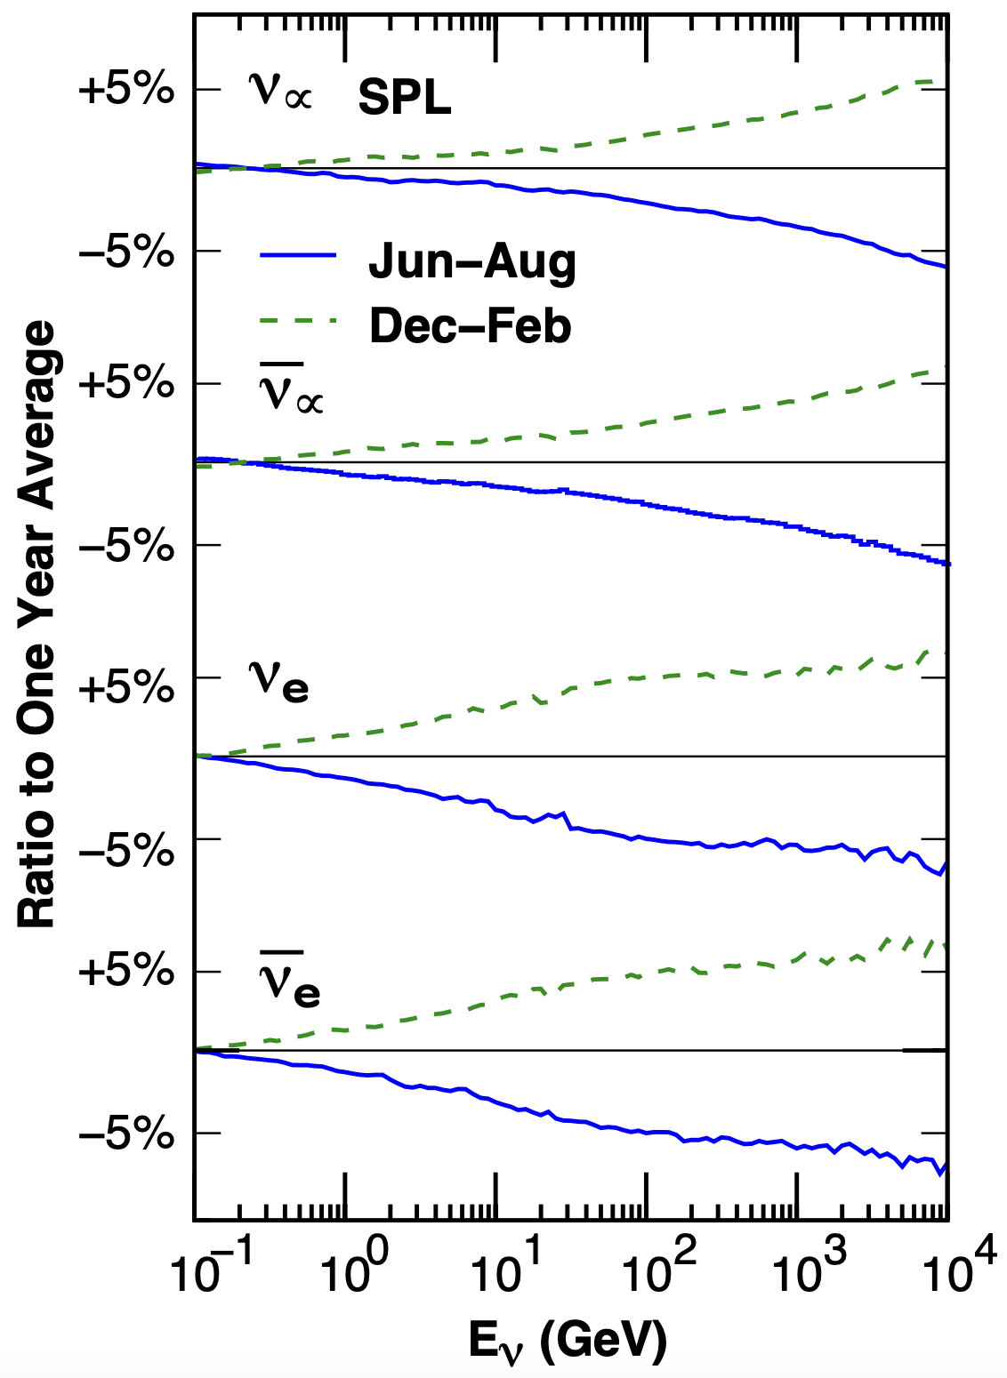
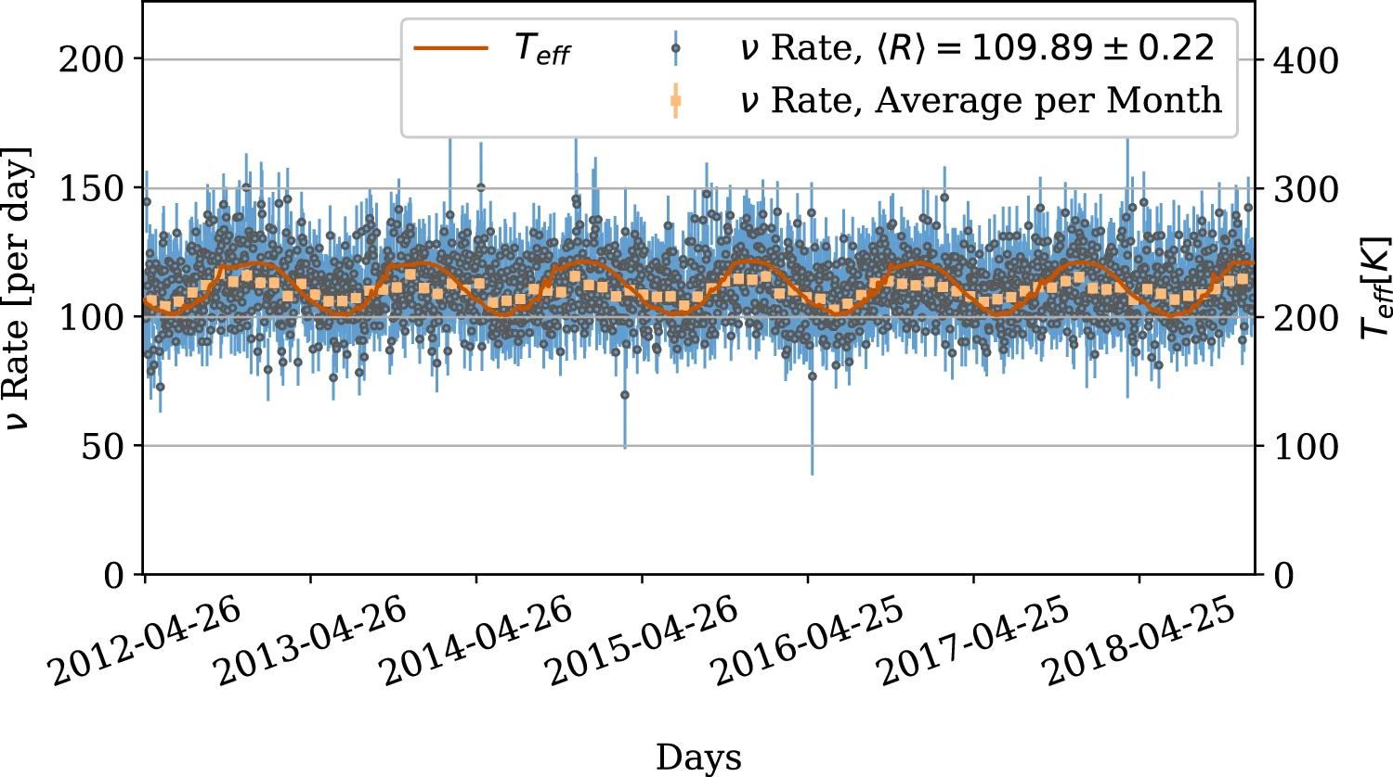
Seasonal Variations of Atmospheric Neutrinos
10.1140/epjc/s10052-023-11679-5
10.1103/PhysRevD.92.023004

Slide 15
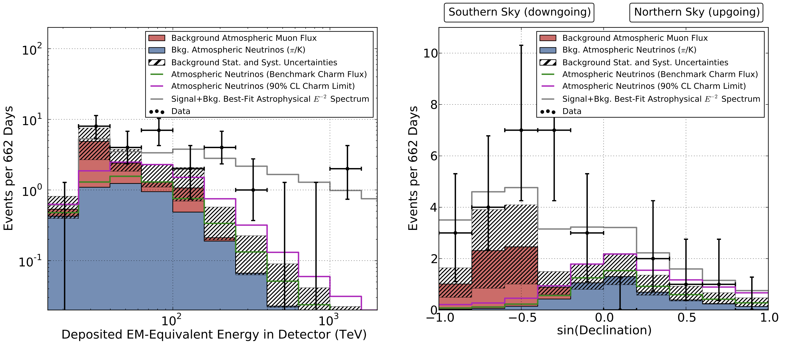
Astrophysical Neutrinos Discovered
10.1126/science.1242856

Slide 16
16

Slide 17
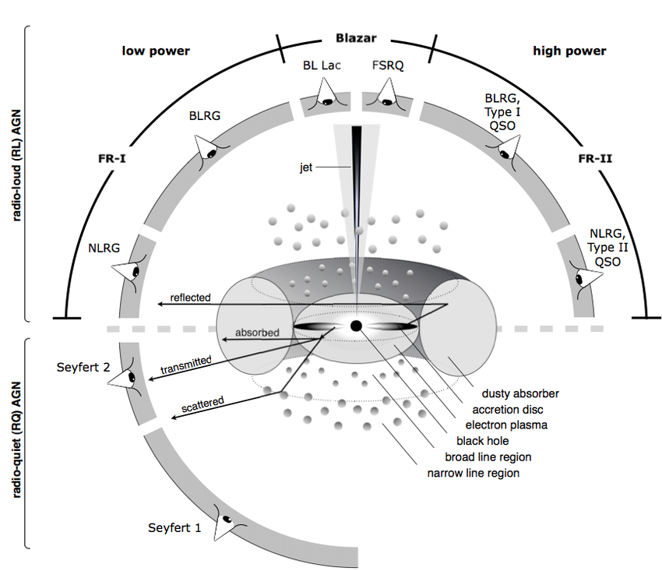
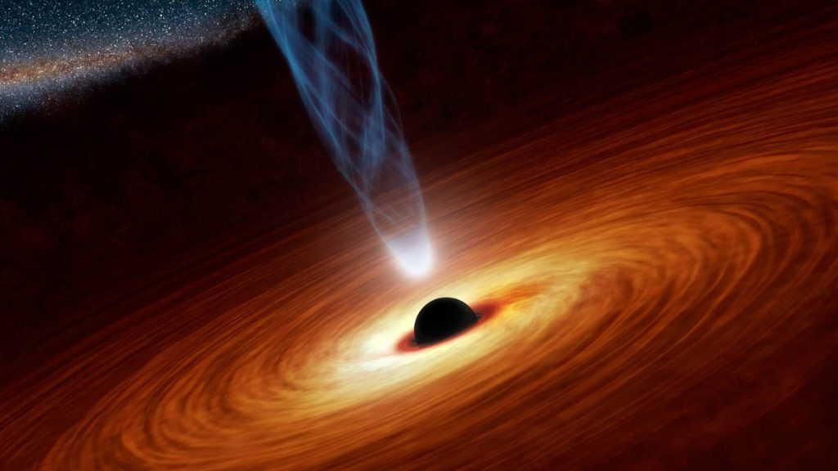
Active Galactic Nucleus (AGN)
escape2020
Beckmann & Shrader 2012

Slide 18
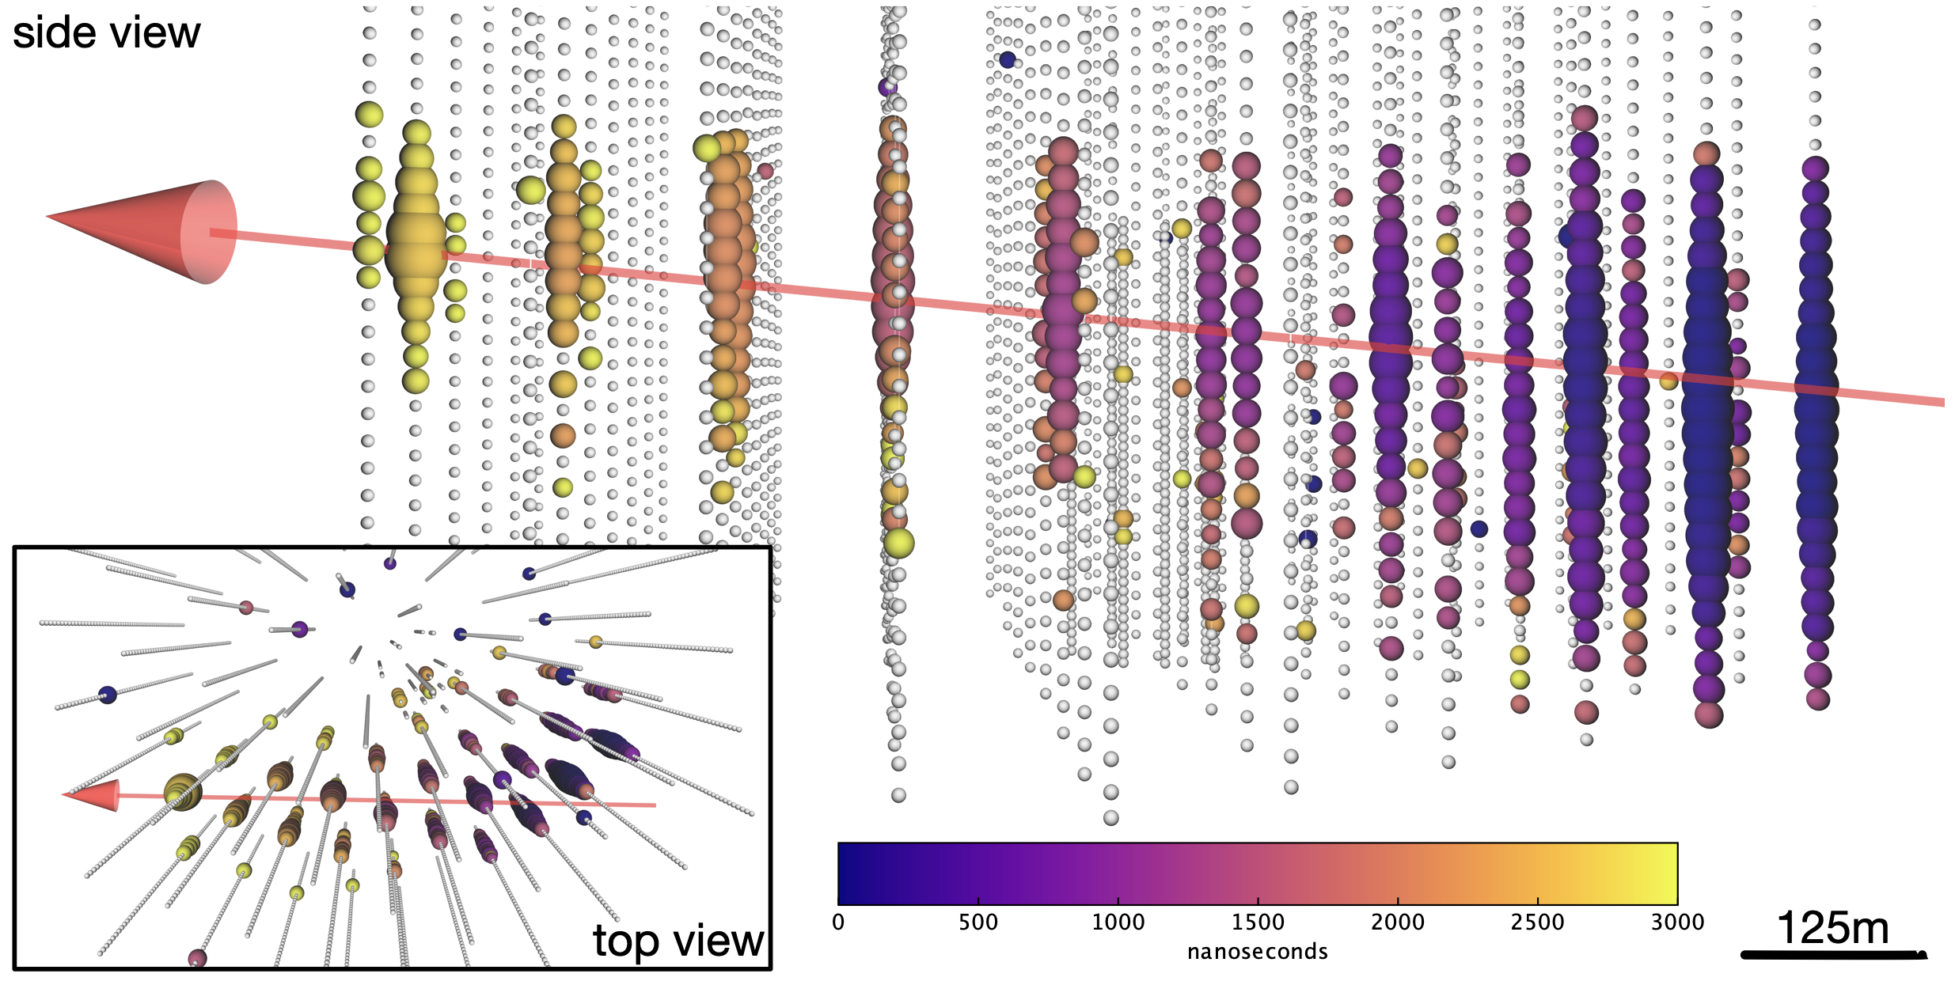
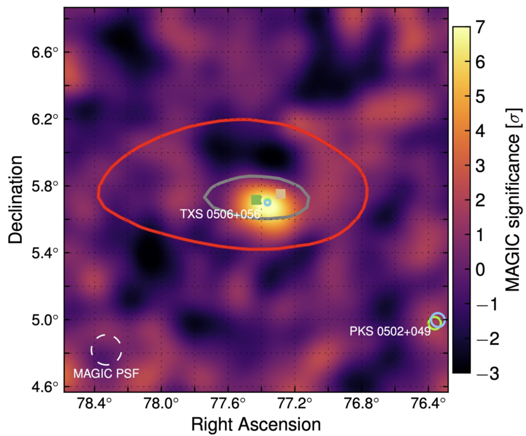
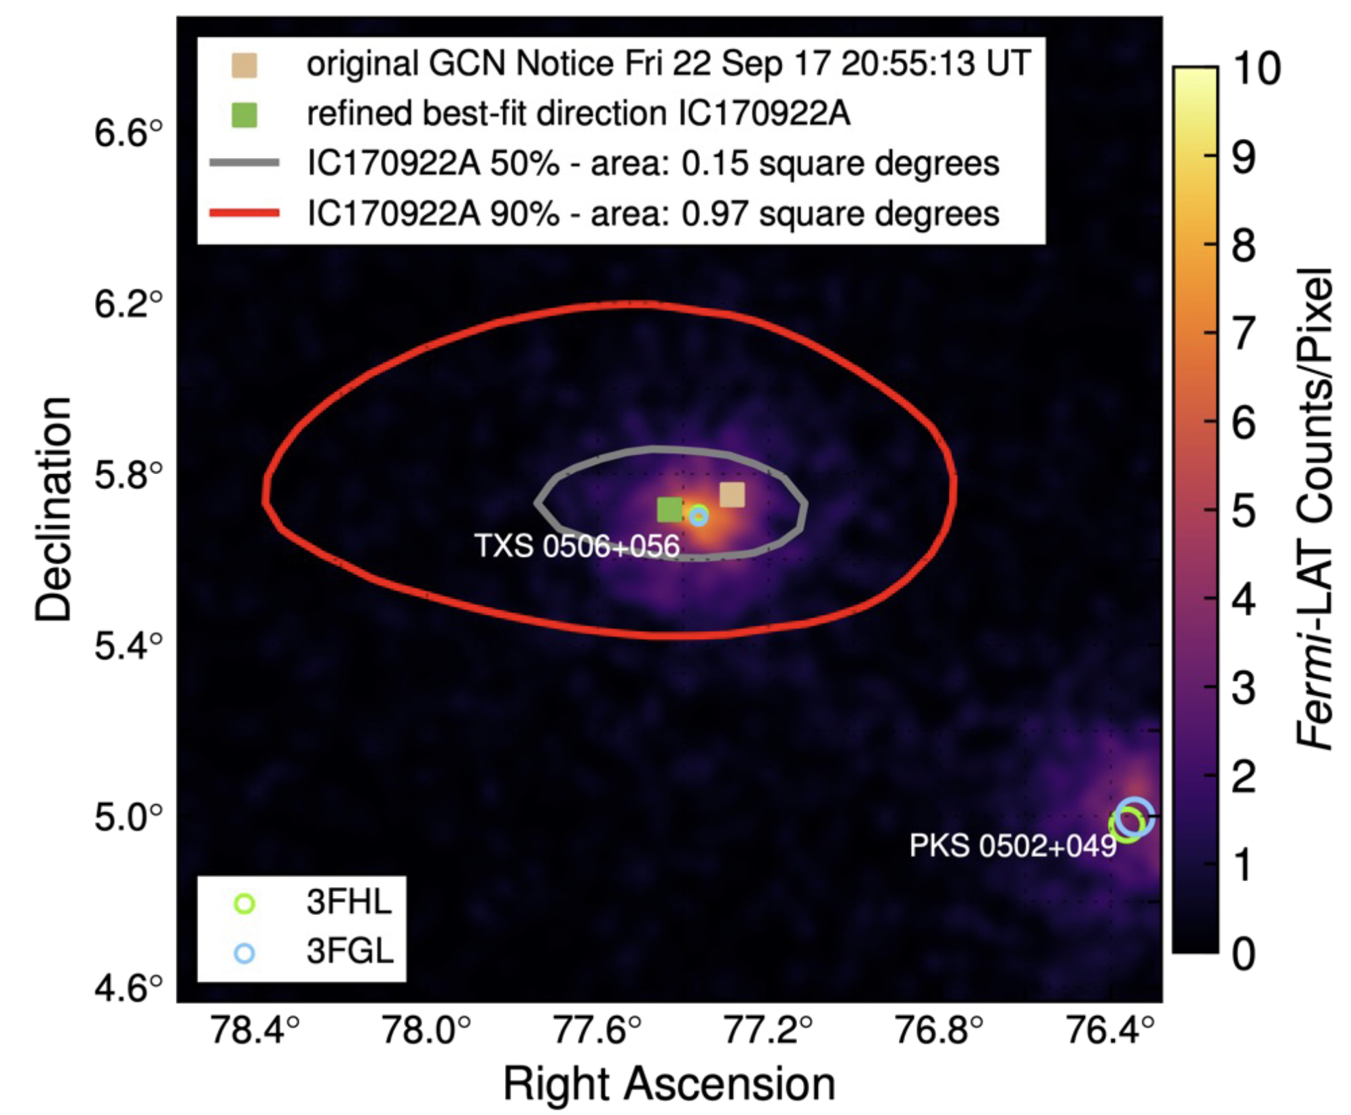
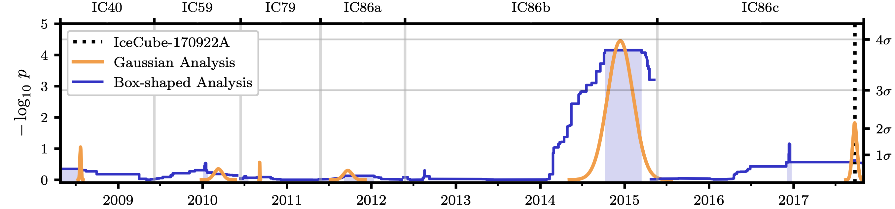
First Source TXS 0506+056 Identified
10.1126/science.aat1378
IceCube-170922A
10.1126/science.aat1378
E >290 TeV
10.1126/science.aat2890

Slide 19
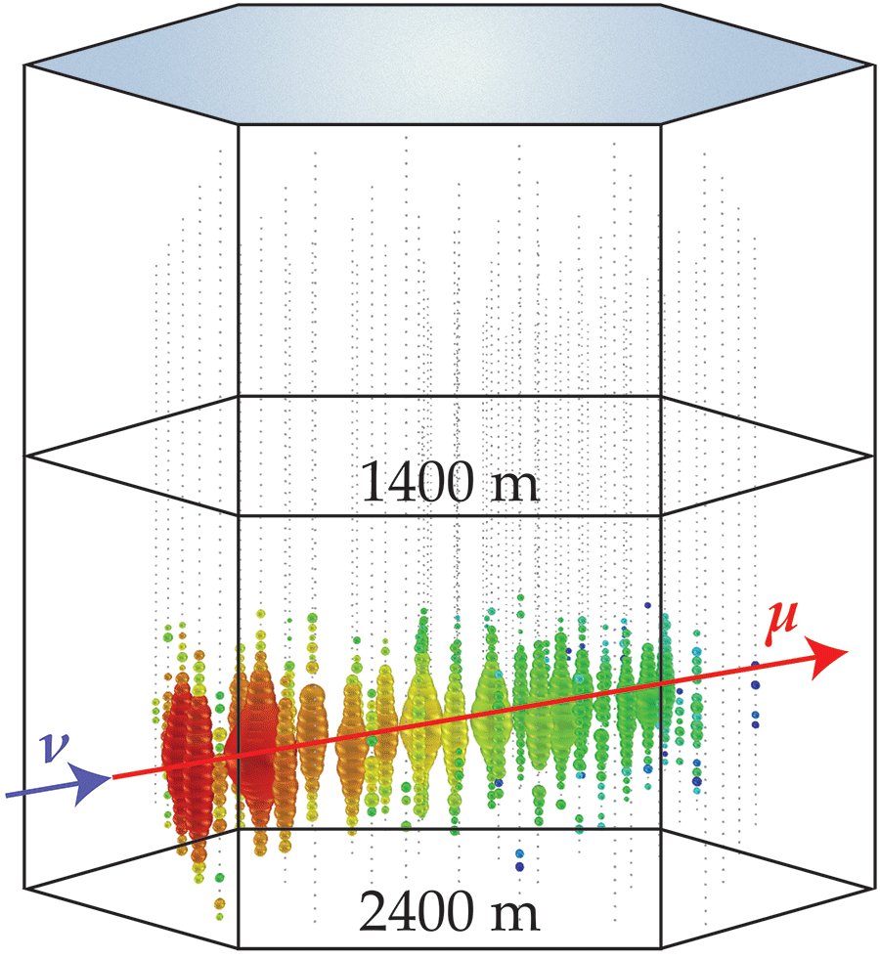
Muon Deflection – Motivation
Illustration: APS/Joan Tycko
10.22323/1.444.1197

Slide 20

Muon Deflection – Simulation
PRopagator with Optimal Precision and Optimal Speed for All Leptons
Used in:
IceCube
KM3NeT
NOvA
NuRadioMC
CORSIKA 8
TAMBO
Baikal-GVD
P-One
type
d
E_{i}
E_{f}
medium
developed and mainted in Dortmund
github.com/tudo-astroparticlephysics/PROPOSAL

Slide 21
Muon Deflection – Results
10.22323/1.444.1197
10.1140/epjc/s10052-022-11102-5

Slide 22
Muon Deflection – Data/MC
7.3 GeV, 1.44 cm copper
199 MeV, 1.09 cm liquid H₂
10.22323/1.444.1197

Slide 23
23

Slide 24
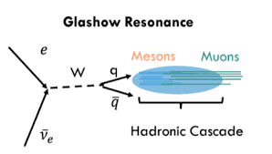
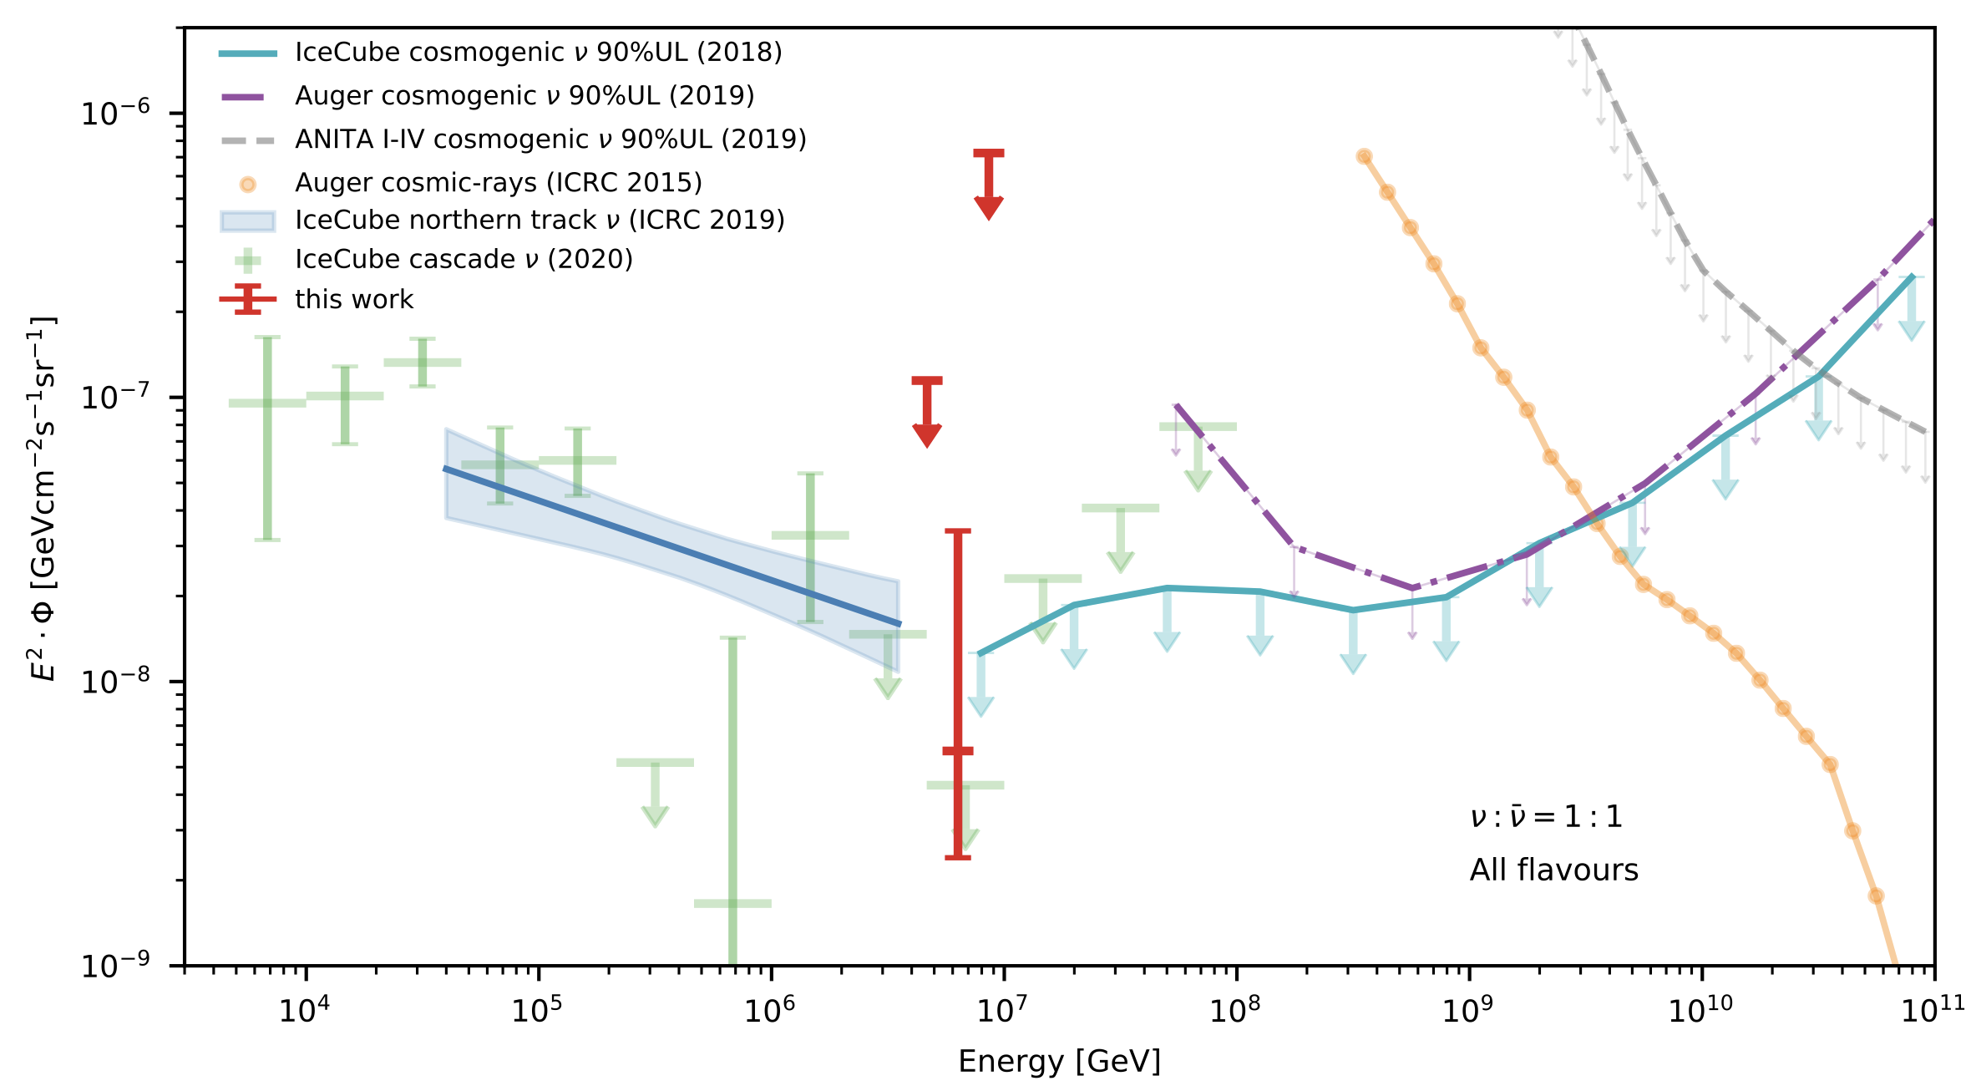
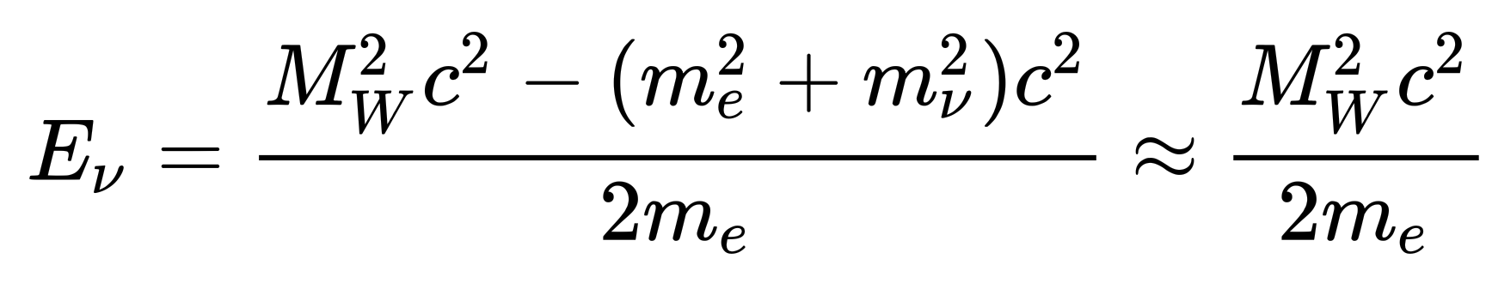


Glashow Resonance Neutrino Identified
10.1038/s41586-021-03256-1
6.3 PeV

Slide 25
25

Slide 26


Second Source NGC 1068 Identified
10.1126/science.abg3395

Slide 27
27

Slide 28

Multiwavelength Milky Way

Slide 29





Why was our galaxy not been detected before?
Selection
Hypothesis
Neural Network
Hybrid reconstruction method:
Combines maximum-likelihood estimation with deep learning
Modeling of high-dimensional PDFs via neural networks
Exploits available information and symmetries
Improved resolution over entire energy range
Expectation $\vec{λ}$
Update hypothesis
Likelihood
Data $\vec{x}$
DOI: 10.22323/1.395.1065
Reconstruction
Machine Learning

Slide 30



Third Source Milky Way Identified
After trial-correction: $4.5σ$
Model | Signal Events | Pre-trial p-value ($Nσ$)
$$π^{0}$$ | 748 | $$1.26×{10}^{−6} (4.71σ)$$
$${KRA}_{γ}^{5}$$ | 276 | $$6.13×{10}^{−6} (4.37σ)$$
$${KRA}_{γ}^{50}$$ | 211 | $$3.72×{10}^{−5} (3.96σ)$$
$π^{0}$: based on Fermi-LAT gamma-ray measurements (DOI: 10.1088/0004-637X/750/1/3)
${KRA}_{γ}^{5/50}$: based on Gaggero et. al (DOI 10.1088/2041-8205/815/2/L25)
10.1126/science.adc9818

Slide 31
Multiwavelength Multimessenger Milky Way
neutrinos

Slide 32
The Muon Puzzle

Slide 33

Cosmic Ray Flux
1903.07713

Slide 34


The Muon Puzzle
”muon number”
2108.08341

Slide 35

The Muon Puzzle
Expected z
2108.08341

Slide 36




Air Shower Profiles – 10 TeV
zeuthen.desy.de
Ralph Engel 2005
2211.16970v2
Proton
Iron

Slide 37

Possible Solutions
Hans Dembinski

Slide 38






Connection to LHC
Hans Dembinski
10.1103/PhysRevD.83.054026

Slide 39

Atmospheric Prompt Muons and Neutrinos
10.1103/PhysRevD.100.103018

Slide 40
The Future of IceCube

Slide 41


IceCube Upgrade
nbi.ku.dk
icecube.wisc.edu

Slide 42




IceCube Gen-2
icecube.wisc.edu

Slide 43



Radio Neutrino Astronomy
Radio:
larger attenuation length
covers bigger volume
detect higher energies
Askaryan effect -> similar to Cherenkov effect -> charge anisotropy
-> emission of radio radiation -> particle energy scales with frequency
2010.12279
10.3847/1538-4357/ac4d29

Slide 44

Conclusion
neutrinos

Slide 45
Backup

Slide 46

Gen2 Modules
icecube.wisc.edu

Slide 47

Possible Solutions
number of secondary particles
fraction of most energetic particle
energy ratio carried by photons
from short-lived hadrons
inelastic hadronic cross-section
10.1007/s10509-022-04054-5

Slide 48

Acoustic Neutrino Detection
hadronic cascade
medium heats up
thermal expansion
acoustic signal (see Askaryan 1957)
Dissertation Matthias Schunck

Slide 49





Galactic Plane Analysis
$$π^{0}→γ+γ$$
$$π^{+} → μ^{+}ν_{μ} → e^{+}ν_{e}{\overline{ν}}_{μ}ν_{μ}$$
$π^{−} → μ^{−} {\overline{ν}}_{μ} → e^{−}{\overline{ν}}_{e}ν_{μ} {\overline{ν}}_{μ}$
1. Ackermann et al. The Astrophysical Journal 750, no. 1 (April 2012): 3.
2. Gaggero et al The Astrophysical Journal 815, no. 2 (December 2015): L25.

Slide 50


Galactic Plane Analysis

